Slide 1

Global Classification Using Clustering and PCA
Identifying Nations by their development status

Slide 2
Team Members
Soumya Ranjan Moharana
R Gayathri
Nivedita K
Nuzhat Ghare
Anurag Gundapi
Siddhartha satla

Slide 3
Objective
To group countries based on key development and economic indicators
Apply clustering techniques (KMeans, Hierarchical, DBSCAN)
Compare performance and interpret cluster profiles
Understand differences between developed, developing, and emerging nations

Slide 4
Dataset Overview
Dataset: World_development_measurement
2976 rows, 25 columns
19 numerical, 6 categorical features
Features: GDP, CO₂ emissions, Life Expectancy, Internet Usage, Health Expenditure, Population, etc.
Country column used as identifier (not for clustering)

Slide 5
Data Cleaning & Preprocessing
Removed unwanted symbols (%, $, ,)
Converted categorical columns to numeric
Dropped irrelevant column (Number of Records)
Missing values: Dropped >40% missing cols, imputed others with median
Log-transform on skewed features
Outlier handling with IQR capping
Scaling with Standard Scaler

Slide 6
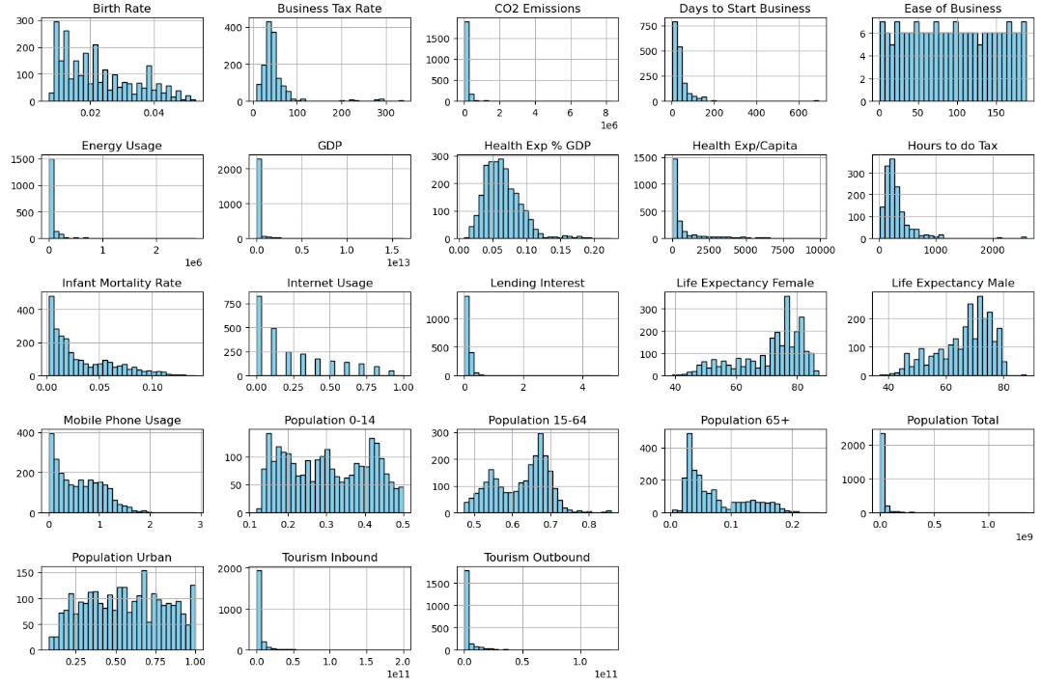
Exploratory Data Analysis (EDA)
Checked distributions (histograms & skewness)

Slide 7
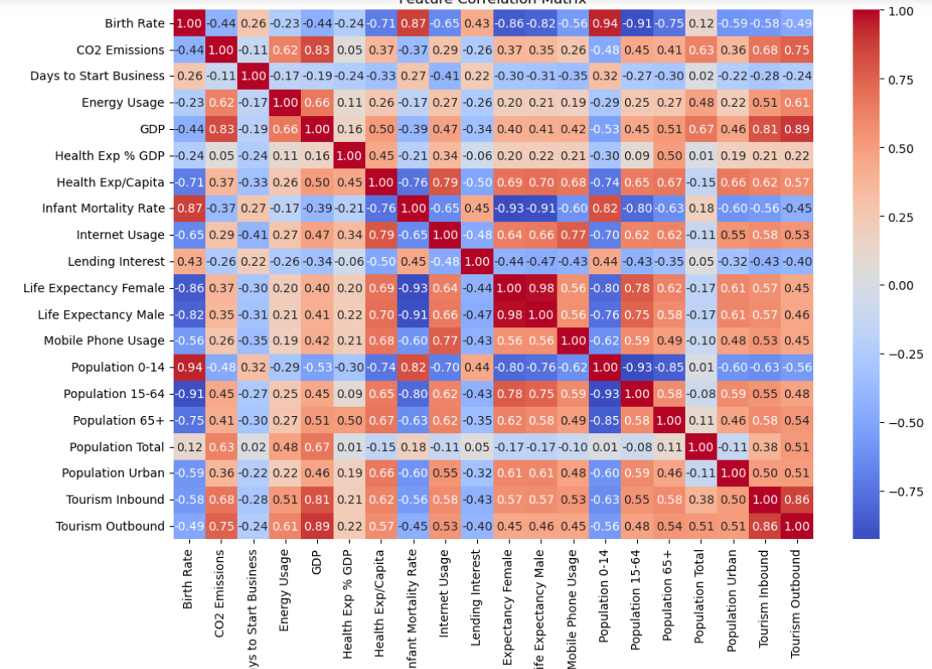
Exploratory Data Analysis (EDA)
Correlation heatmap

Slide 8

Dimensionality Reduction (PCA)
Purpose:
Reduce dataset dimensionality while retaining most of the variance (information).
Variance Retained:
11 components explain ~95% of the total variance.
This ensures minimal loss of information while simplifying the dataset.
Benefits:
Removes noise and redundant features.
Reduces computational cost for clustering.
Helps improve cluster separation in some cases.
Application in this study:
KMeans and HAC clustering applied on PCA-transformed data.
Performance compared against clustering on full scaled data.

Slide 9
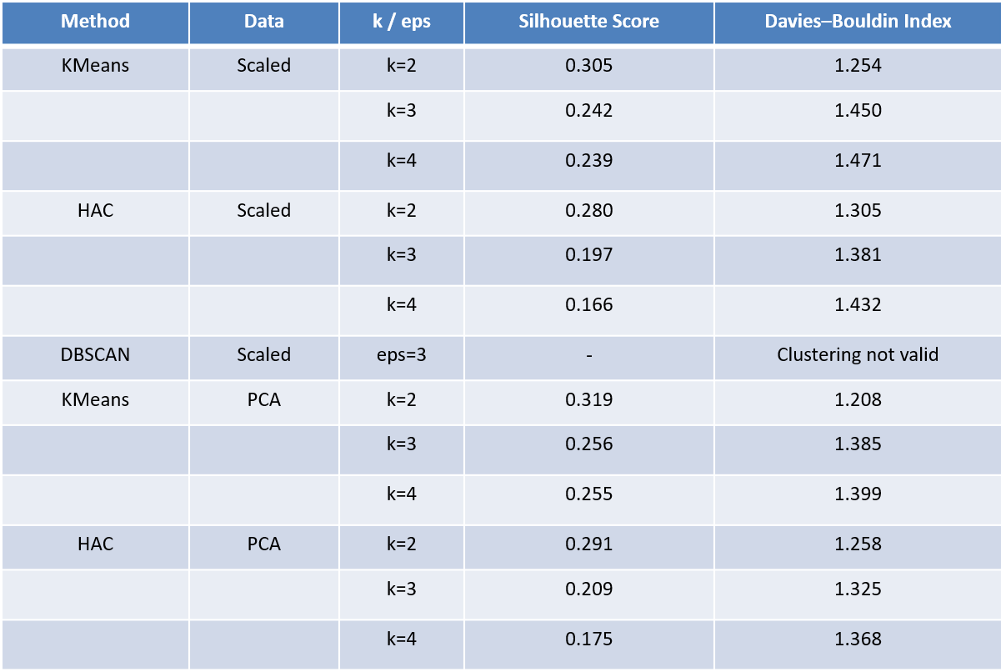
Clustering Techniques
Best Model: KMeans (PCA, k=2)
Silhouette Score: 0.319
Davies Bouldin Index: 1.208
This model provides the most compact and well-separated clusters compared to other methods and parameter choices.

Slide 10
Cluster Profiling
Cluster 0 - Developed nations
High GDP, Low Infant Mortality, High Internet Usage
Cluster 1 - Developing economies
Moderate GDP, Growing population, Improving infrastructure
Cluster 2 - Least Emerging nations
Low GDP, High Infant Mortality, Low Internet Usage

Slide 11
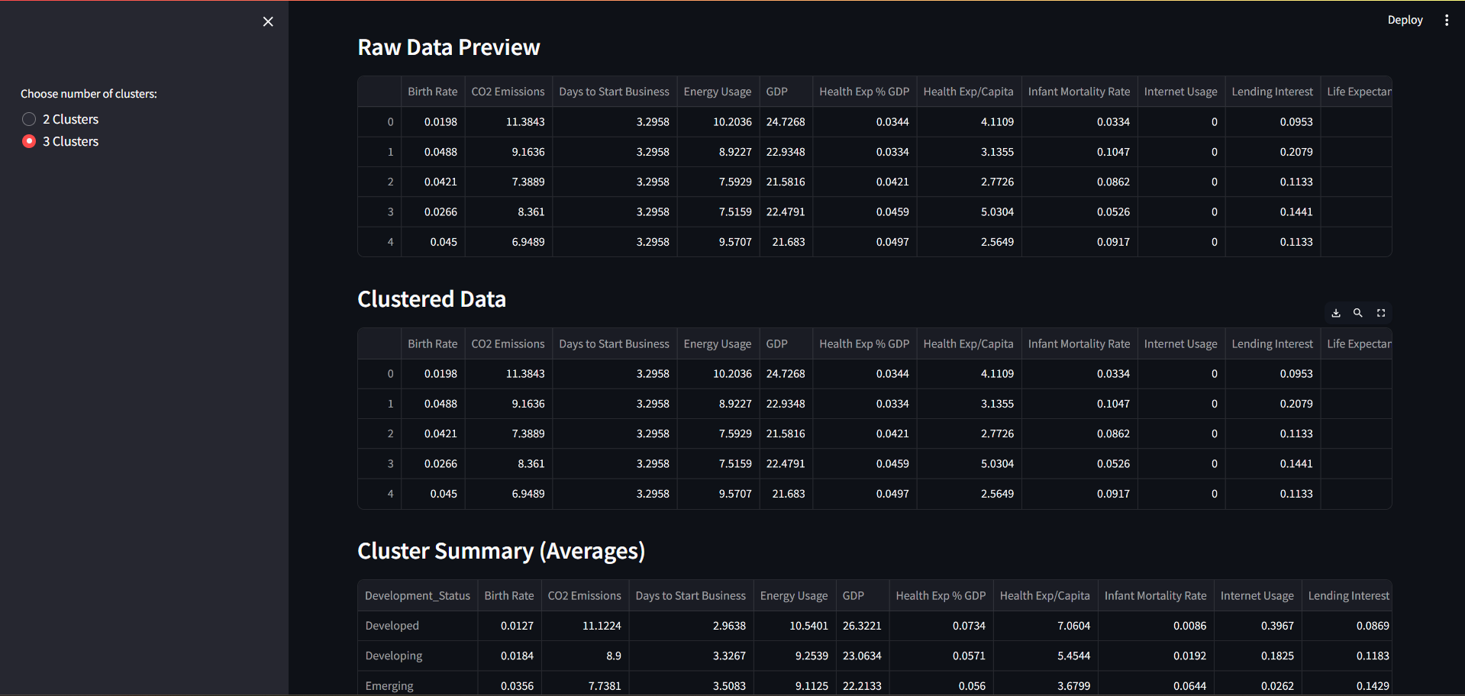
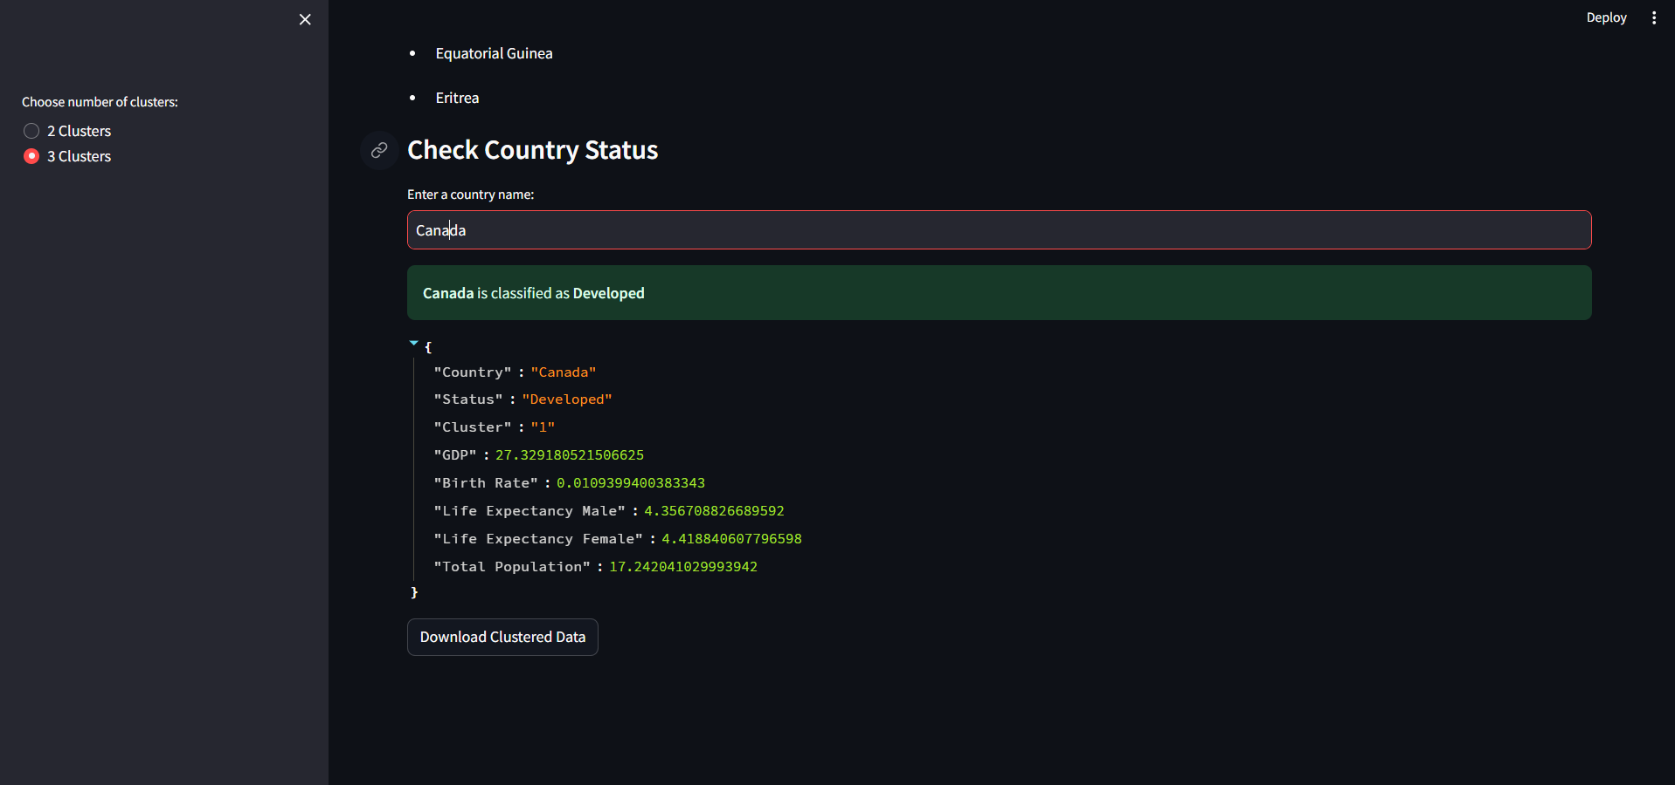
Deployment

Slide 12
Conclusion
KMeans with PCA (k=3) provided best separation
Clear distinction between developed, emerging, and least developed countries
PCA improved clustering performance and interpretability
DBSCAN less effective due to high dimension data

Slide 13

Thank You

